Slide 1


Meal Benefits Income Eligibility
The Basis for Program Reimbursement

Slide 2

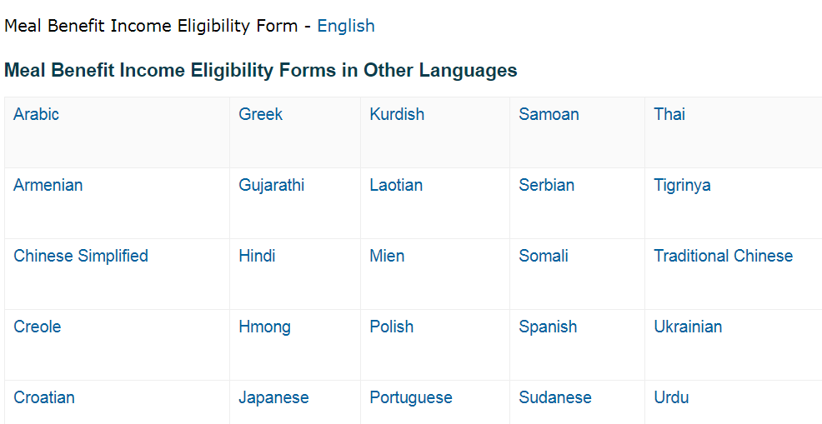
https://www.fns.usda.gov/cacfp/meal-benefit-income-eligibility

Slide 3
CACFP Rates of Reimbursement
Per Meal Rate
1
Rate determined by Household Income Eligibility
2
New rates released every July
3
Paid to Institutions for providing participants “free” reimbursable meals.
4
Additional Cash-in-Lieu rate - for lunch and dinner meals claimed, when Institution does not receive USDA Commodities.
5
https://www.fns.usda.gov/cacfp/reimbursement-rates

Slide 4
Eligibility Classifications
Three categories based on total household income:
Free
Facilities receive reimbursement based on the number of participants falling into each category
Paid
Reduced

Slide 5
Reviewing Eligibility Applications
Review for Completeness
Determine Eligibility Category
Summarize on Eligibility Record
Update/Monitor Changes and Dates
Report Eligibility Totals Monthly

Slide 6
ANNUAL DOCUMENT
ENROLLMENT MUST BE COMPLETED
Only the last four digits of the Social Security #
Parent/Guardian Signature
Must include date and phone #s.
Your Center’s Representative

Slide 7
Recommended that you sign first then make copies.

Slide 8
RACIAL/ETHNIC IDENTIFICATION
Notes:
8

Slide 9
ENROLLMENT INFORMATION

Slide 10
Option 1A: SNAP/TANF Beneficiaries
For Child Care participants
Signature of Adult Household Member ________________ Date _______

Slide 11
Option 1B: Foster Child
Foster children are categorically eligible as “free” with appropriate documentation
Check the box, and list any personal income such as the participant’s allowance, clothing or school fees
Staple verification to the eligibility application

Slide 12
Option 2: SNAP, SSI or Medicaid
For Adult Care participants only
OPTION 2: SNAP (FOOD STAMPS), SSI OR MEDICAID BENEFICIARIES
If you are now receiving SNAP (Food Stamps), SSI or Medicaid, complete one of the following numbers:
SNAP CASE # _____________ SSI# ________________ MEDICAID # ___________
Signature of Adult Household Member ________________ Date _________
NOTE: IF PARTICIPANT IS UNABLE TO SIGN, ADULT HOUSEHOLD MEMBER IS AUTHORIZED

Slide 13
Option 3: Household Income
Total Household Monthly Income
SALARY ______________________________________ | SS/PEN./RETIRE _________________________________ | UNEMPLY WORK COMP ____________________________________________ | WELFARE/ CHILD SUPP. ____________________________________________ | TOTAL __________________________________________
TOTAL GROSS HOUSEHOLD INCOME: _ ___________
0 income is unrealistic
ADULT HOUSEHOLD CERTIFICATION
SIGNATURE & DATE
SOCIAL SECURITY #
HOME TELEPHONE #
HOME ADDRESS

Slide 14
PRIVACY ACT STATEMENT :
Institution must make determination and sign

Slide 15
Make a file copy
ENROLLMENT AND ELIGIBILITY CHANGES
Place in alphabetical Order by Classroom
Be consistent on all forms including Attendance & Meal Counts
Do not delete!
Draw a RED LINE
through the participants
information.
TOTALS
CHANGE
MONTHLY

Slide 16
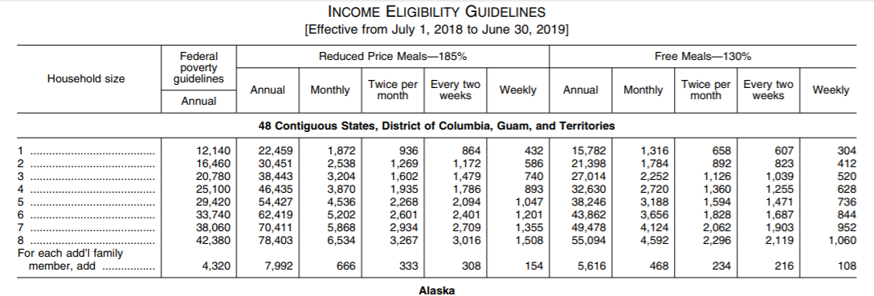
CURRENT Income Eligibility Scale

Slide 17
Converted Income Scale
CHILD AND ADULT CARE FOOD PROGR
AM FAMILY SIZE AND INCOME SCALE
EFFECTIVE JULY 1,
20
1
3
THROUGH JUNE 30,
20
1
4
FOR DETERMINING ELIGIBILITY FOR FREE, REDUCED AND PAID RATES OF REIMBURSEMENT
HOUSEHOLD
FREE
REDUCED
PAID
SIZE
ANNUAL
MONTHLY
WEEKLY
ANNUA
L
MONTHLY
WEEKLY
ANNUAL
MONTHLY
WEEKLY
1
$0
-
$
15
,
171
$0
-
$1,
2
65
$0
-
$
2
92
$1
5,172
-
$
2
1
,
590
$1,2
66
-
$1,
800
$
2
93
-
$
4
16
$
2
1
,
591
and up
$1,801
and up
$
417
and up
2
$0
-
$
20,
449
$0
-
$1,
705
$0
-
$
3
94
$
20
,
450
-
$2
9,101
$1,
706
-
$2,
42
6
$
3
95
-
$
5
60
$2
9,102
and up
$2,
427
and up
$
5
61
and up
3
$0
-
$2
5
,
727
$0
-
$
2
,
1
44
$0
-
$
4
95
$2
5
,
728
-
$3
6
,
612
$
2
,
145
-
$
3
,
0
51
$
4
9
6
-
$
705
$3
6
,
613
and up
$
3
,
052
and up
$ 706
and up
4
$0
-
$
3
1,005
$0
-
$2,
5
84
$0
-
$
5
97
$
31,006
-
$
4
4,123
$2,
585
-
$3
,
6
77
$
5
98
-
$
8
49
$
4
4,124
and up
$3,
678
and up
$
8
50
and up
5
$0
-
$3
6,283
$0
-
$
3,024
$0
-
$
6
9
8
$3
6,284
-
$
51
,
634
$3,025
-
$
4
,
303
$
6
99
-
$
9
93
$
51
,
635
and up
$
4
,
304
and up
$
9
94
a
nd up
6
$0
-
$
4
1
,
561
$0
-
$
3,
4
64
$0
-
$
800
$
4
1
,
562
-
$5
9,145
$
3,
465
-
$4,
929
$
801
-
$
1,
1
38
$59,146
and up
$4,
930
and up
$
1,
139
and up
7
$0
-
$4
6
,
839
$0
-
$3,
904
$0
-
$
901
$4
6
,
840
-
$
6
6,656
$3,
905
-
$
5,
555
$
902
-
$1,
2
82
$
6
6,657
and up
$
5
,
556
and up
$1,
283
and up
8
$0
-
$
5
2,117
$0
-
$
4
,
344
$0
-
$
1,003
$
5
2,118
-
$
7
4,167
$
4
,
345
-
$
6
,
1
81
$
1,004
-
$1,
4
2
7
$
7
4,168
and up
$
6
,
182
and up
$1,
428
and up
Each Additional
+
5
,
278
+
4
40
+
10
2
+
7,
511
+
6
2
6
+
1
4
5
Family Member

Slide 18

RECAP
Determining an Eligibility Application
    Review
    Determine
    Summarize
Notes:
So far, we learned how to review the Income Eligibility Application, Determine the eligibility classification, and Summarized each application on the Eligibility record. Remember, Income Eligibility Applications are not required for the At Risk Afterschool Meals Program and Emergency Shelters.

Slide 19
Updating Your Eligibility Record
Record Monthly Changes
Additions / Deletions (Entering Participants and Withdrawals )
Enter Effective Date
Re-Total No. Enrolled: Free - Reduced – Paid
Record Figures on Monthly Voucher
Copy Eligibility Record, Report, and File

Slide 20
Updating & Monitoring Changes
Name of Enrolled Participant |  | Date of Eligibility Application | Date of * CACFP Enrollment | Date of CACFP Withdrawal |  | ELIGIBILITY DETERMINATION |  |  |  | HOURS OF CARE | DAYS OF CARE (Check () All That Apply)
(Last Name, First Name) |  | (Mo/Date/Yr) | (Month/Yr) | (Month/Yr) |  | F |  | R | P | Time: ( From - To) | M | T | W | TR | F | S | SU
 |  |  |  |  |  | F = Free R = Reduced P = Paid |  |  |  |  | _{Monday} | _{Tuesday} | _{Wednesday} | _{Thursday} | _{Friday} | _{Saturday} | _{Sunday}
1 | Akhad, Tameka | 7/14/13 | 9/1/13 |  | X |  |  |  |  | 7 AM – 6 PM | X | X | X | X | X
2 | Allmay, Erica | 7/17/13 | 9/1/13 |  | X |  |  |  |  | 7 AM – 5 PM | X | X | X | X | X
3 | Cummings, Charles | 7/31/13 | 9/1/13 |  |  |  |  |  | X | 8 AM – 6 PM | X | X | X | X | X
4 | Delio, Anita | 8/14/13 | 9/1/13 |  |  |  |  |  | X | 9 AM – 3 PM | X | X | X | X | X
5 | Roberts, Austin | 7/21/13 | 9/1/13 |  | X |  |  |  |  | 7 AM – 5 PM | X | X | X | X | X
6 | Smith, Rodger | 8/5/13 | 9/1/13 |  |  |  |  |  | X | 8 AM – 4:30 PM | X | X | X | X | X
7 | Speirs, Susan |  | 9/1/13 |  |  |  |  |  | X | 6 AM – 3 PM | X | X | X | X | X
8 | Whitaker, Walter | 8/20/13 | 9/1/13 |  | X |  |  |  |  | 8 AM – 3 PM | X | X | X | X | X
9 | White, Maurice |  | 9/1/13 |  |  |  |  |  | X | 7 AM – 2 PM | X | X | X | X | X
10 | Williams, Leon | 7/25/13 | 9/1/13 |  |  |  |  |  | X | 8 AM – 4 PM | X | X | X | X | X
11
9/30/13
x
x
10/11/13
x
10/17/13
Weible, Ron
10/18/13
10/18/13
x
9 AM – 5 PM
x x x x x
10
Effective Date: | Oct. 2013 | Total Enrollment = |  | Free |  | + | Reduced |  | + | Paid
5
2
3

Slide 21
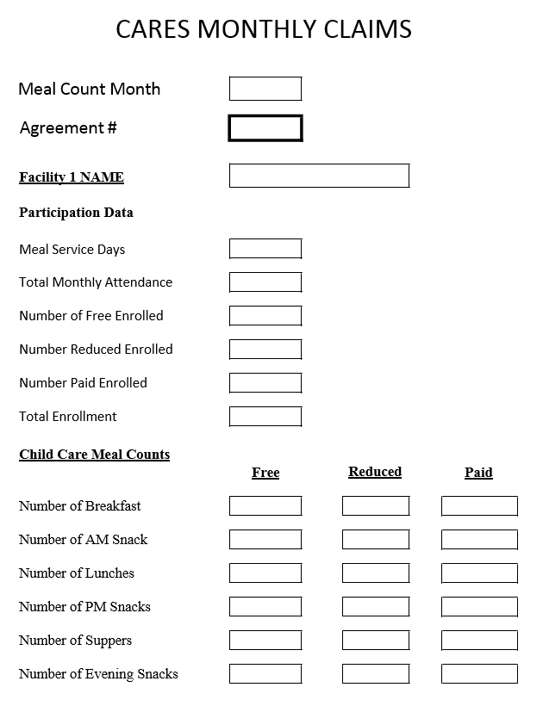
Reporting Eligibility Totals on CARES Electronic System

Slide 22
Data Reported for EACH Facility
Report Eligibility and Enrollment Data Monthly
5
2
3
10

Slide 23
Eligibility application RE-CAP
Review for Completeness
Determine Eligibility Category
Summarize on Eligibility Record
Update/Monitor Changes and Dates
Report Eligibility Totals in CARES

Slide 24

Recordkeeping Requirements

Slide 25
Maintaining CACFP Documentation
  Schedule A
  Eligibility Record
  Attendance Records
  Meal Count Records
  Vouchers
  Monitoring/Household Contact Surveys
  Dated Menus
  Child Nutrition (CN) Food Labels
  Vendor Contracts
  Delivery Slips
  Cost Documentation
  Staff Training Forms
  Civil Rights Documentation
  Renewal Application
  501C Tax Documentation/Formation Papers
  Procurement Standards
Notes:
25
Again, these are most of the program documents you must maintain on file up to five years; unless there is an active administrative review, which more time is required.

Slide 26



WHAT TYPE OF SYSTEM WORKS FOR YOU?

Slide 27
What is the Schedule A
Update program changes within 10 days.
Use red pen to make changes.
Signed by authorized CACFP Program Representative .

Slide 28
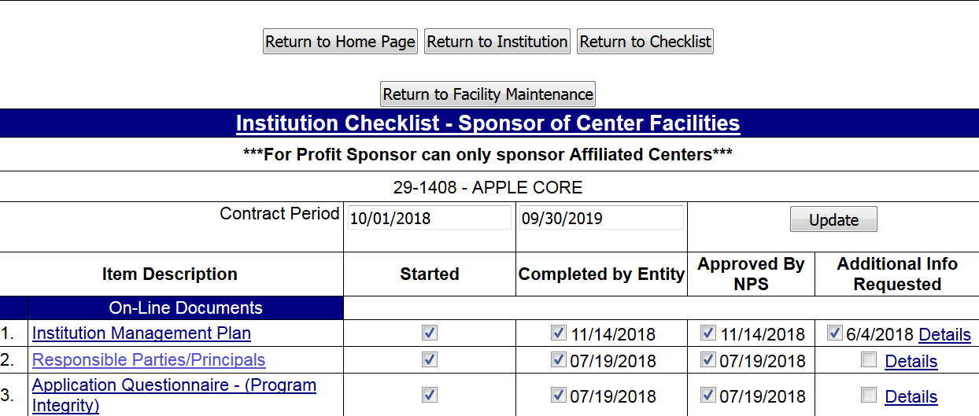
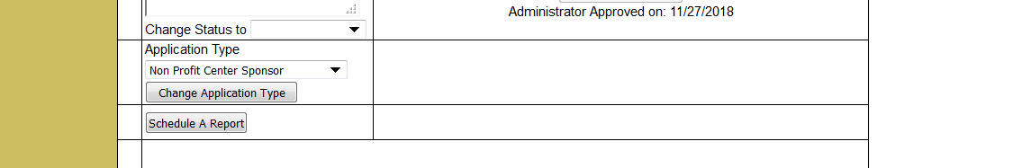

Slide 29
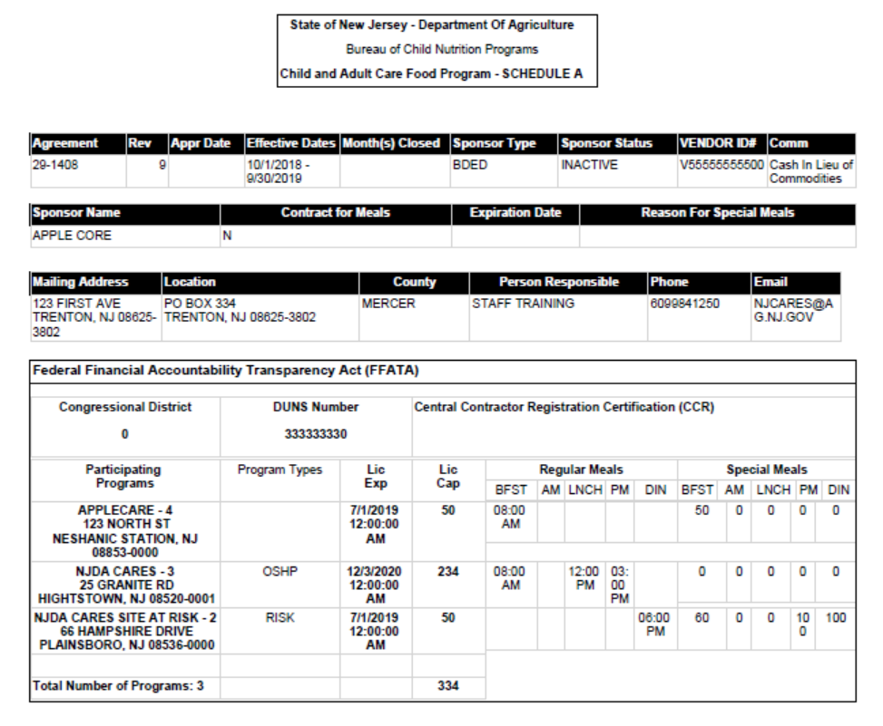
CARES Schedule A Report Example

Slide 30
ATTENDANCE FORM
TOTAL ATTENDANCE FOR THE ENTIRE MONTH

Slide 31
Updating & Comparing Eligibility Record to Attendance Record

Slide 32
Updating & Comparing Eligibility Record to Attendance Record RECAP
Gather Attendance Updates
Determine New Income Eligibility Applications (IEA)
Update Existing IEAs
Update Eligibility Record

Slide 33
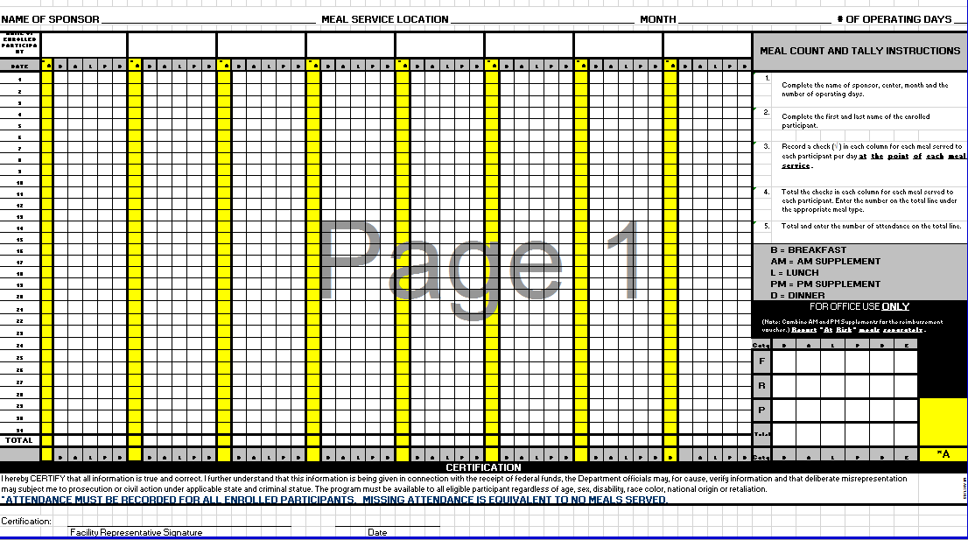
NEW REQUIRED DOCUMENT
ATTENDANCE & MEAL COUNTS RECORD
Record at the Point of each Meal Service
No Overt Information
Notes:
33

Slide 34
Apple Core Day Care Center
Butterflies
April 0_
12
F
R
P
F
12 12 12 12 12 12 12 12 1 1 1 1 3 3 3 3

Slide 35
April
Data Reported for EACH Facility
21-0999
Butterflies
22
371
15
3
6
24
Report Meal Count Data Monthly
247
62
59
250
62
59
243
59
59

Slide 36
MEAL COUNT RECAP
Use Required Form
List Participants’ First and Last Names
Place Names in Alphabetical Order
TAKEN AT THE POINT OF MEAL SERVICE
No Overt Information
Total Each Page

Slide 37
Assessing Costs in the Child and Adult Care Food Program (CACFP)
Cost Principles Factors when determining the allow-ability of costs:
  Be necessary and reasonable for proper and efficient administration of the Programs
  Be allocable to Federal awards applicable to the administration of the Programs
  Be authorized and not prohibited under State or local laws
Notes:
Cost Principles”; requires grantees receiving Federal funds to consider the following factors when determining the allow-ability of costs:

Slide 38
Typical costs considered allowable include:
Operating Costs Compensation
  Food service labor and office staff working solely for the CACFP
  Food and Nonfood supplies (e.g., napkins, trays, utensils)
  Food service nonexpendable equipment
Administrative Costs
  Planning, organizing, and managing a food service operation under the CACFP to accomplish:
    reviewing and submitting facility applications to the State agency for CACFP participation approval;
    reviewing and approving income eligibility statements;
    providing nutrition education to CACFP staff;
    providing CACFP training for institution staff and facilities; and
    conducting CACFO monitoring and training visits to sponsored facilities

Slide 39
Typical Costs Considered Unallowable Include:
Losses arising from uncollectable accounts including when reasonable efforts have been made to collect them
Payment of overclaims, fines, and/or penalties resulting from Program violations
Entertainment (e.g., social activities, amusements)
Costs not included in the CACFP’s budget as approved
Capital expenditures (e.g., acquisition of land and buildings, the alteration of existing facilities)
Initial purchase of vehicles
Non-business purchased communication costs (e.g., personal cell phones, internet services, etc.)

Slide 40
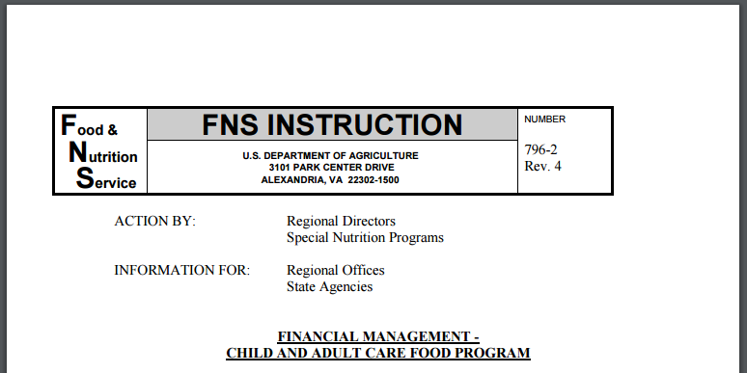
What is the FNS Instructions 796-2 Rev. 4?
https://fns-prod.azureedge.net/sites/default/files/796-2%20Rev%204.pdf
Notes:
CACFP funds are provided to assist State agencies through grants and other means to initiate and maintain nonprofit food service Programs for eligible children and adult participants in nonresidential institutions that provide care. This Instruction establishes Program standards, principles and guidelines for financial management. Download a copy from this website.

Slide 41
FNS Instructions 796-2 Rev. 4
Assure that costs charged to the nonprofit food service are for food service provided principally to:
  enrolled,
  eligible participants; and
  where applicable, that costs claimed for reimbursement under the CACFP are necessary and reasonable for effective and efficient operation of the nonprofit food service, and are otherwise allowable under the Federal cost principles and this Instruction;
Provide financial management guidance to State agencies pursuant to 7 CFR §226.7(m) for CACFP financial management systems;
Provide guidance to institutions in developing the financial information needed to comply with the requirements of the CACFP; and
Provide guidance so that to the extent practicable, all institutions of similar type doing the same work will be subject to the same requirements.
Notes:
The FNS Instructions, assures costs charged are for enrolled, eligible participants, and costs are necessary and reasonable. This instructions provides financial management guidance to State agencies and institutions in maintaining the same requirements and compliance in accordance with CACFP Regulations.

Slide 42
COST DOCUMENTATION
  Prepare Itemized Listing of cost documentation.
  Invoices/Receipts must be itemized.
  Documentation of non-food, food service labor, purchased services, etc.
  Documentation to show 66% of 85% of edible food was spent.
  Proof of vendor delivery slips
  Proof of milk purchases
  *COMPARE AMOUNT SPENT ON EDIBLE FOOD TO MONTHLY REIMBURSEMENT RECEIVED

Slide 43
COST DOCUMENTATION SAMPLE
DATE | SUPPLIER | TOTAL PURCHASE | FOOD | NONALLOWABLE | FOOD LABOR | OTHER(Non-Food) |  | AMINSTRATIVE LABOR | ADMINSTRATIVE OTHER
4/24/08 | Stop & Shop | 27.72 | 10.77 | 16.95
4/12/08 | Stop & Shop | 5.99 | 5.99 | -
4/28/08 | Stop & Shop | 19.95 | 19.95 | -
4/18/08 | Victor's Pizza | 79.00 | 79.00 | -
4/4/08 | Victor's Pizza | 81.00 | 81.00 | -
4/10/08 | Victor's Pizza | 74.00 | 74.00 | -
4/16/08 | Costco | 595.44 | 495.44 | 25.76 |  | 74.24
4/8/08 | Sicomac Dairy | 145.42 | 145.42 | -
4/7/08 | Target | 31.26 | - | 31.26
4/26/08 | Costco | 443.94 | 443.94
4/30/08 | Stop & Shop | 42.80 | - | 42.80
4/30/08 | Victor's Pizza | 85.00 | 85.00
4/11/08 | Driscoll Food | 184.09 | 184.09
4/30/08 | Driscoll Food | 319.94 | 319.94
4/30/08 | Stop & Shop | 27.90 | - |  |  | 27.90
4/18/08 | Medco | 23.90 | - |  |  | 23.90
 |  |  | -
 |  |  | -
Donations |  |  | -
Food Bank |  |  | -

Slide 44
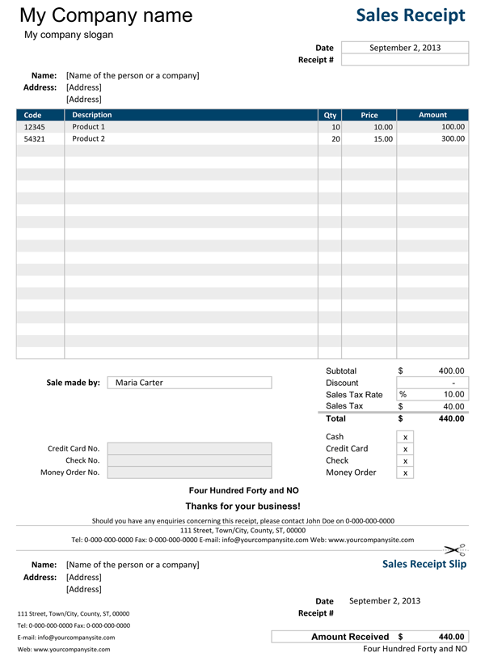
Maintain All Food Receipts
ALL RECIEPTS MUST BE ITEMIZED
ONLY CLAIM CREDITABLE ITEMS

Slide 45
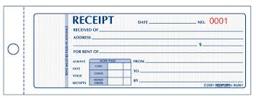
Donations
  Name of Agency Donating Items
  Quantity/Unit Portion Size
  Dollar Value
  Date
  Signatures

Slide 46
CHILD AND ADULT FOOD DISTRIBUTION PROGRAM
All our USDA Food purchases are certified and inspected to meet quality standards. Only high grades of meats, fruits and vegetables are offered.
The USDA Foods meet the current specifications of reduced fats, sugars and salts.
Pick-up locations: Newark or Vineland - You have the choice to pick up or contract with a carrier.
Number of monthly allocations based on Average Daily Participation (ADP):
  20 or less = 1 allocation offered during the year
  21 – 49 = 2 allocations offered – one for March and one for September
  50 or more = 9 monthly allocations
Note: This is in place of the Cash-in-Lieu rate .2350

Slide 47
Examples of current participants in the USDA Food Distribution Program
September 2018 – May 2018 – Monthly Allocations
Client # 9621170 Client #9717710
Accepted all 9 months Accepted 7 months
Entitlement $5,427.00 Entitlement $13,568.38
Accepted $5,953.92 Accepted $11,163.38
Gained $ 526.92 Lost $ 1,404.62

Slide 48
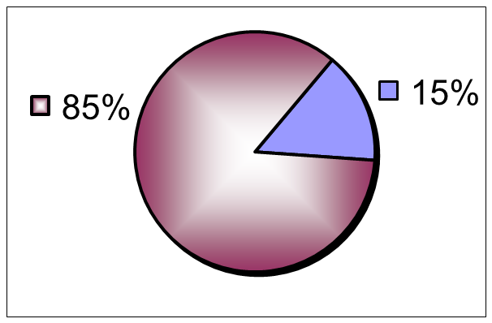
Estimating Maximum CACFP Reimbursement
Best Practice Model
Food Service Costs:
Food, Labor, Non-Food
Supplies
Administrative Costs:
Admin. Labor,
Office Supplies, etc.

Slide 49
Record Keeping Recap
Meal counts taken at the point of meal service
No overt identification (FRP)
Total each page
Verify attendance and eligibility records
Review Meal Verification
Conduct Household Contacts
Monitor and Maintain Costs
Verify all documents prior to submitting reimbursement claim
Maintain CACFP documents for 3 years

Slide 50
Thank you!
Call your specialist with questions:
609.984.1250

